Slide 1
Breaking Bulbs Briskly By Bogus Broadcasts
Joe Hall and Ben Ramsey

Slide 2
Goals
Release some Z-Wave recon tools
Break some fluorescent bulbs

Slide 3


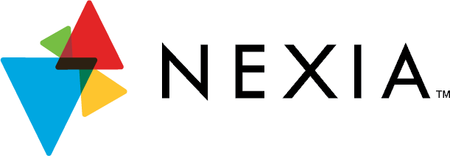



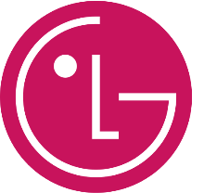
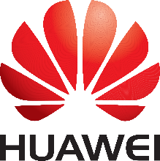
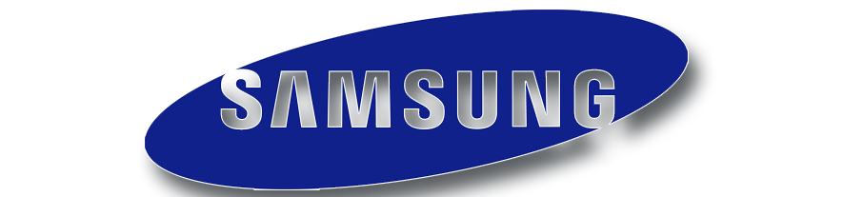



Z-Wave
Low-rate wireless network protocol
Proprietary: no SDK without NDA!
Big in automation & security systems

Slide 4
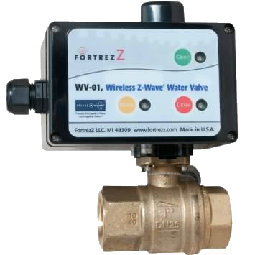
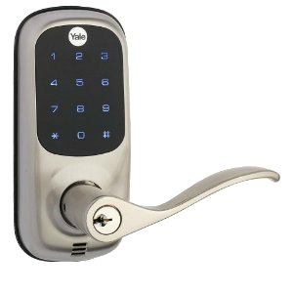
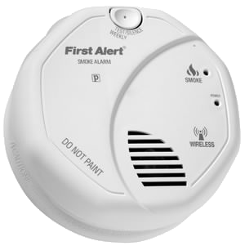
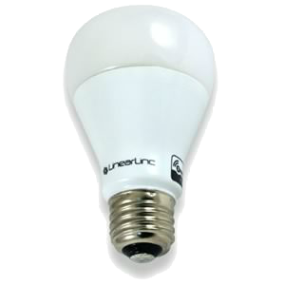
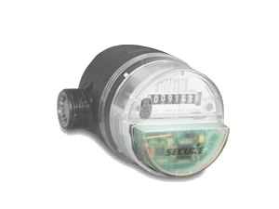
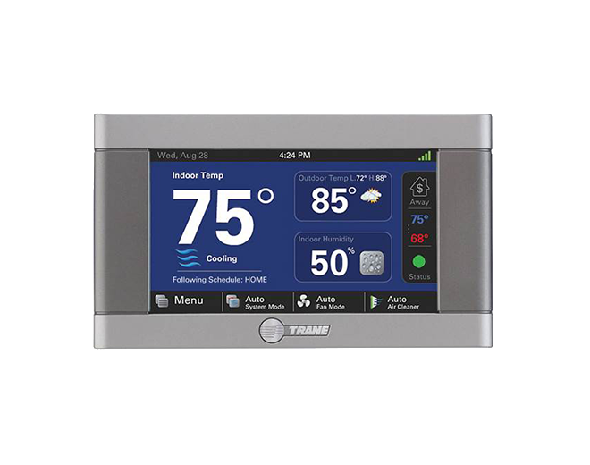
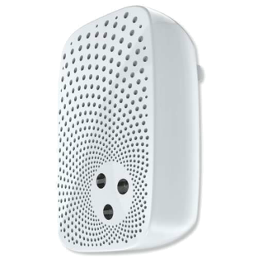
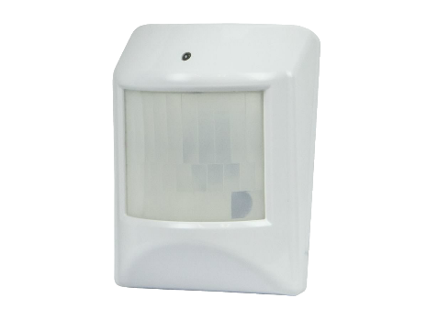
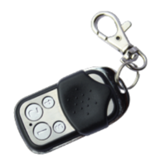
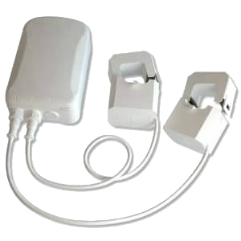
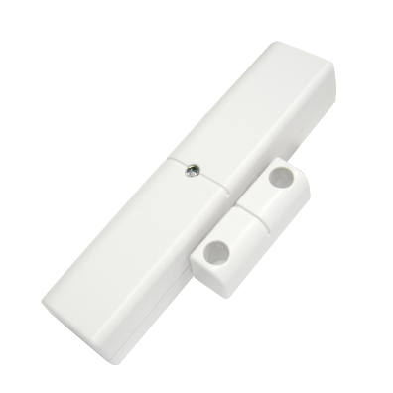
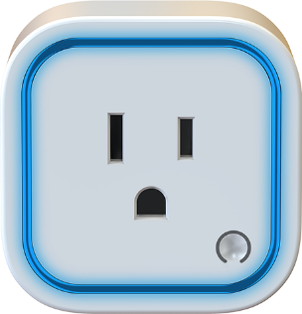
Z-Wave
Notes:
With reportedly over 35 million sold since 2005, devices range smart plugs and lightbulbs to door locks and smoke detectors to water valves and smart meters.
(break)
Ben here has been doing security research on a similar wireless protocol called ZigBee for a handful of years.
When I started working for him, he asked me to evaluate the security of Z-Wave.

Slide 5
What’s Out There?
Open-ZWave
Open source libraries
Control devices via Z-Wave USB stick
Z-Force (BH ’13 – Fouladi & Ghanoun)
Commodity radio
Custom firmware, closed-source software
Scapy-radio (BH ’14 – Picod et al.)
Generic wireless sniffer/injector using software-defined radios
Open source, uses GNU Radio and Scapy

Slide 6
EZ-Wave
Built on top of Scapy-radio
Extended support for Z-Wave protocol
Includes 3 tools:
ezstumbler: network discovery & enumeration
ezrecon: device interrogation
Manufacturer / product name
Software versions
Supported command classes
Current state
Configuration settings
ezfingerprint
Determines Z-Wave module generation
PHY manipulation to exploit differences in transceivers
Not available when encryption is used

Slide 7
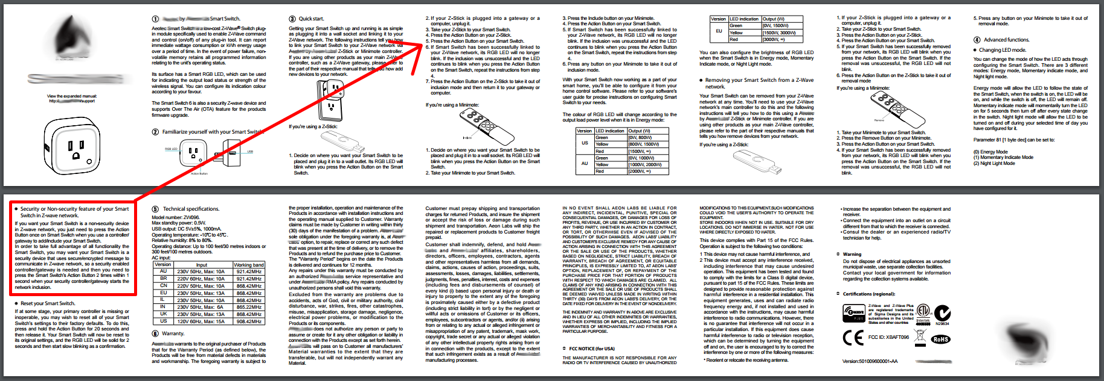
A Note About Security
The protocol supports AES-128
Up to the device manufacturer to use it…
Only 9 of 33 devices we tested support encryption
5 door locks & 4 newer devices
3 of the 4 were ‘opt-in’ security…

Slide 8

Demo
Notes:
So here’s a quick demo of EZ-Wave.
For time sake, I’m skipping network discovery and go straight to network enumeration.
Up here I have a network setup with a few devices paired.
(demo ezstumbler)
Now, I’m going to use ezrecon to interrogate one of the devices we found.
(demo ezrecon)
(switch to Ramsey)
Well you might ask what the hell this has to do with break bulbs briskly…
(demo of power cycling devices while Ramsey is saying the following)
While EZ-Wave is geared towards reconnaissance, the messages used to interrogate devices are pretty much the same as those used to control them.
We really wanted to break something, so we did some experiments to see how quickly we could break fluorescent bulbs.

Slide 9
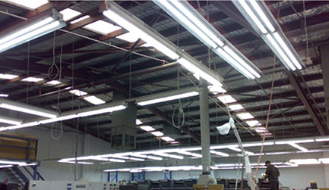
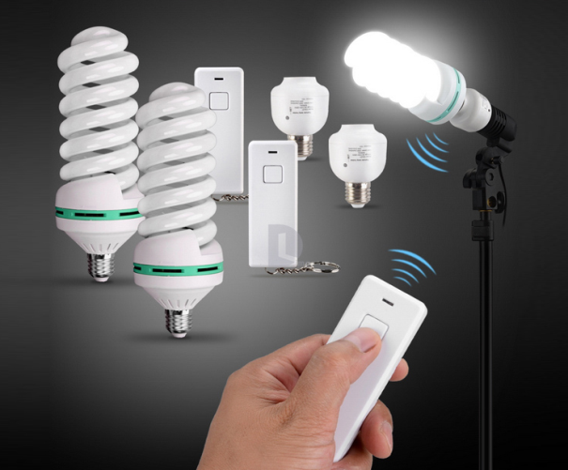
Breaking Bulbs
Z-Wave is not the only smart energy protocol!
2.4 GHz
Wi-Fi
ZigBee
6LoWPAN
WirelessHART
Bluetooth
< 1 GHz
Z-Wave
Insteon
Lutron
Xodus
…

Slide 10
Breaking Bulbs
How do you quickly break fluorescent bulbs?
Turn them on and off rapidly.
C. Spezia and J. Buchanan, “Maximizing the Economic Benefits of Compact Fluorescent Lamps,” J. of Industrial Tech, vol. 27, no. 2, 2011.
At 2 seconds on, 8 seconds off they report:
- Mean CFL failure: 7,300 cycles (20.3 hrs)
- Wide range: 2,000-22,000 cycles (5.6-61.1 hrs)

Slide 11
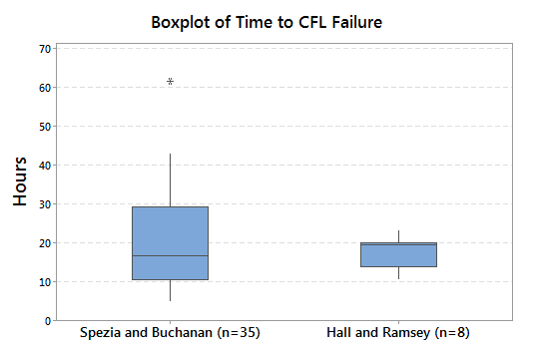
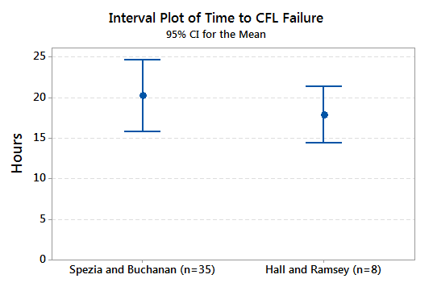
Breaking Bulbs
Trust but replicate
2 seconds on, 8 seconds off
What about industrial lighting?

Slide 12
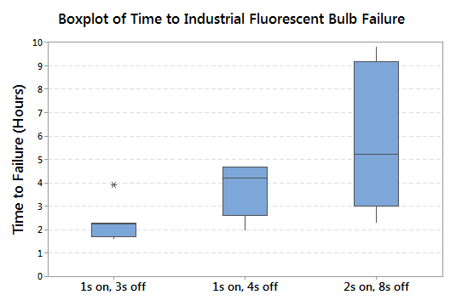
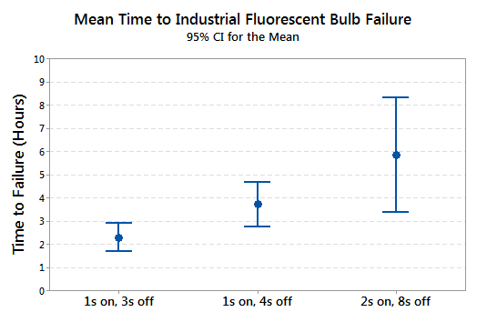
Breaking Bulbs
We can break industrial bulbs faster!
1 second on, 3 seconds off is fastest to fail
(Faster cycles do not provide enough thermal stress)

Slide 13
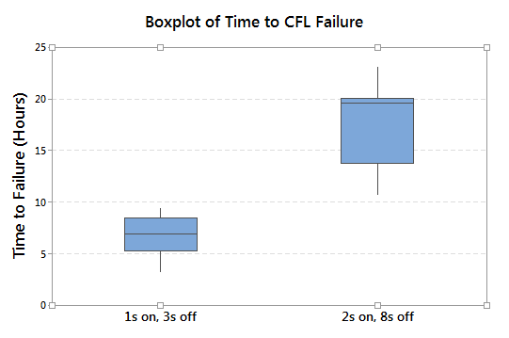
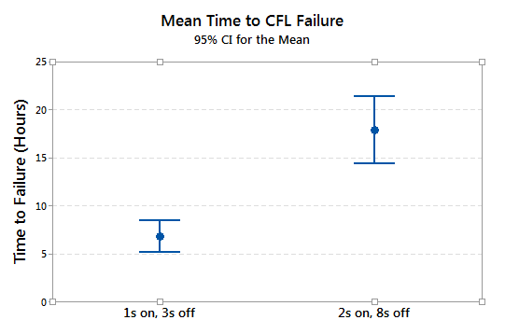
Breaking Bulbs
Does 1 sec on, 3 secs off also work for residential CFLs?
Yes!

Slide 14
Takeaways
Users:
Be mindful when wireless systems control the real world
As always… RTFM!
Device Manufacturers:
Support encryption already…
We’re tired of waiting!
Make it the default…
Let me decide if I don’t want my stuff secure

Slide 15
Questions
EZ-Wave available @
https://github.com/AFITWiSec/EZ-Wave
Let The Forking Begin!

